Slide 1
Approximation Algorithm: Vertex-cover
Session 23
Henry Lucky, S.Kom. M.Kom.

Slide 2
Outline Materials
Session 23
The vertex-cover problem
Linear programming
Approximating weighted vertex-cover problem using linear programming

Slide 3
Learning outcomes
23
LO 1: Explain fundamental concept of analysis algorithms
LO 2: Apply algorithm techniques and methods
LO 3: Solve a problem using specific algorithm.
LO 4: Compare several algorithm design methods

Slide 4
approximation Algorithm
Introduction
Many problems of practical significance are NP-complete, yet they are too important to abandon merely because nobody knows how to find an optimal solution in polynomial time.
Even if a problem is NP-complete, there may be hope.
You have at least three options to get around NP-completeness:
First, if the actual inputs are small, an algorithm with exponential running time might be fast enough.
Second, you might be able to isolate important special cases that you can solve in polynomial time.
Third, you can try to devise an approach to find a near-optimal solution in polynomial time (either in the worst case or the expected case).

Slide 5
approximation Algorithm
Introduction
In practice, near-optimality is often good enough.
We call an algorithm that returns near-optimal solutions an approximation algorithm.

Slide 6
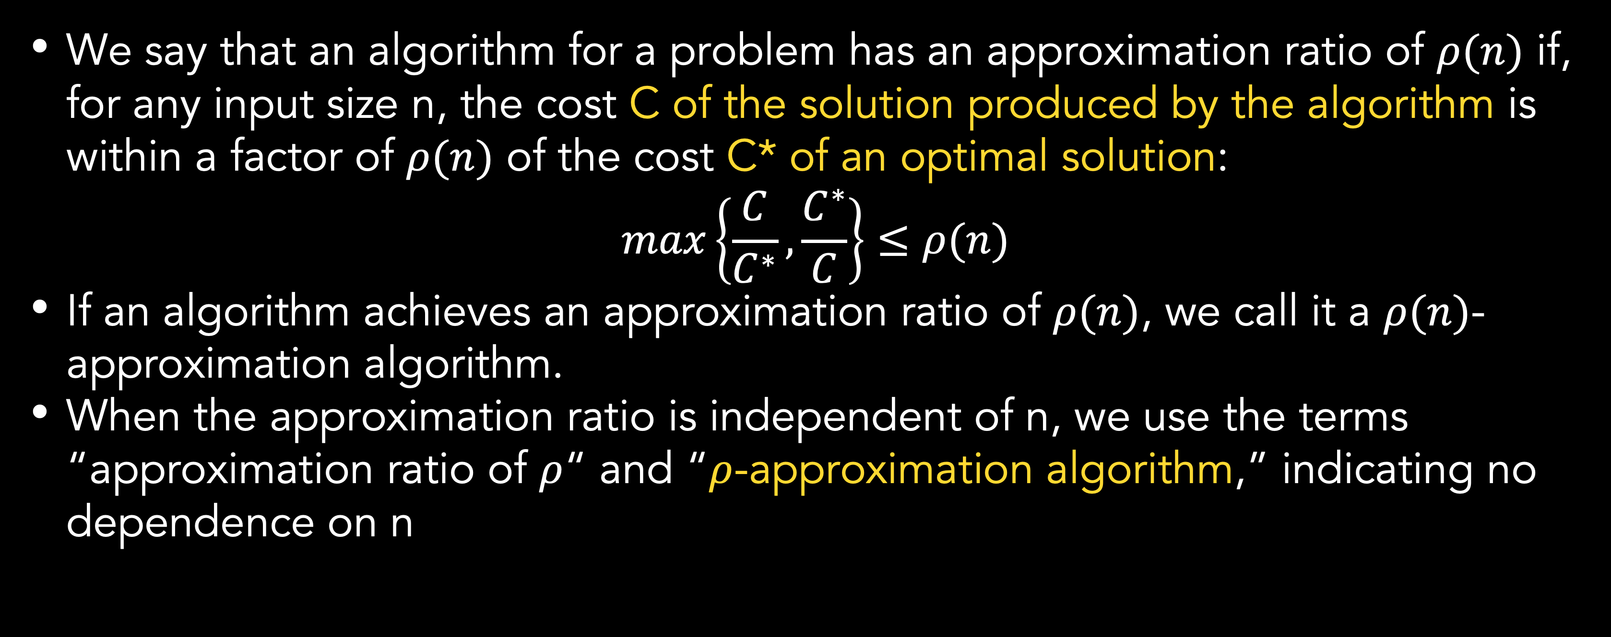
approximation Algorithm
Performance ratios for approximation algorithms
We say that an algorithm for a problem has an approximation ratio of $ρ(n)$ if, for any input size n, the cost C of the solution produced by the algorithm is within a factor of $ρ(n)$ of the cost C* of an optimal solution:
$$max\left\{\frac{C}{C^{∗}}, \frac{C^{∗}}{C}\right\}≤ρ(n)$$
If an algorithm achieves an approximation ratio of $ρ(n)$, we call it a $ρ(n)$-approximation algorithm.
When the approximation ratio is independent of n, we use the terms “approximation ratio of $ρ$“ and “$ρ$-approximation algorithm,” indicating no dependence on n

Slide 7

approximation Algorithm
Performance ratios for approximation algorithms
The definitions of approximation ratio apply to both minimization and maximization problems.
For maximization problem, $0<C≤C^{∗}$, so:
$$C^{∗}≤ρ\left(n\right)∙C$$
For minimization problem, $0<C^{∗}≤C$, so:
$$C≤ρ\left(n\right)∙C^{∗}$$
The equation works because $ρ\left(n\right)$ is never less than 1.
Therefore, a 1-approximation algorithm produces an optimal solution.

Slide 8
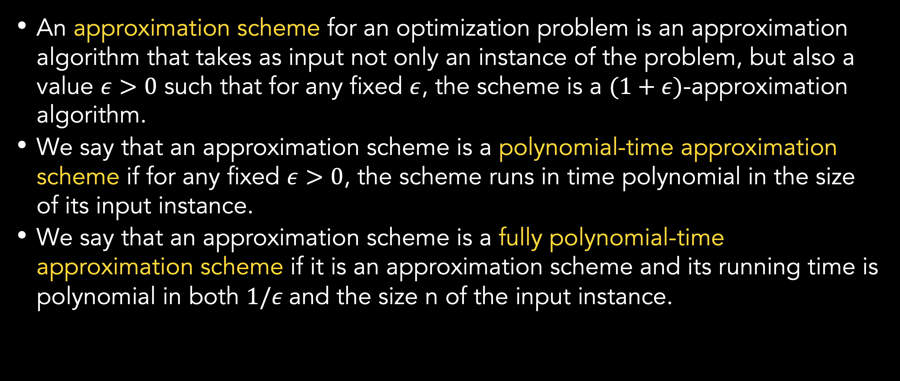
Approximation algorithm
Approximation scheme
An approximation scheme for an optimization problem is an approximation algorithm that takes as input not only an instance of the problem, but also a value $ε>0$ such that for any fixed $ε$, the scheme is a $(1+ε)$-approximation algorithm.
We say that an approximation scheme is a polynomial-time approximation scheme if for any fixed $ε>0$, the scheme runs in time polynomial in the size of its input instance.
We say that an approximation scheme is a fully polynomial-time approximation scheme if it is an approximation scheme and its running time is polynomial in both $1/ε$and the size n of the input instance.
Notes:
We can say that $(1+ε)$ is $ρ$

Slide 9
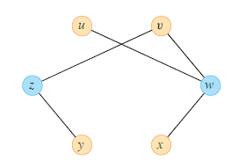
The vertex-cover problem
Formal definition
Input: An undirected graph G(V, E), where V represents the set of vertices and E represents the set of edges.
Output: A vertex cover C, which is a subset of V such that for every edge (u, v) in E, either u or v (or both) must be in C.
The goal is to find the vertex cover C with the minimum number of vertices.

Slide 10
The vertex-cover problem
Solving Strategy
Given its computational complexity, several approximation algorithms and heuristics have been developed to find suboptimal solutions with reasonable computational requirements. Some common approaches include:
Greedy algorithm: This simple approach starts with an empty vertex cover and repeatedly selects the vertex that covers the maximum number of uncovered edges until all edges are covered. While not guaranteed to be optimal, it often yields reasonable results.
Approximation algorithms: There are various algorithms that provide theoretical guarantees on the approximation ratio. For instance, the "2-approximation algorithm" guarantees that the size of the vertex cover it finds will be at most twice the size of the optimal vertex cover.
Integer Linear Programming (ILP): In this approach, the problem is formulated as an ILP problem, and solvers are used to find the optimal integer solution. This method can work well for small to medium-sized graphs but may become infeasible for large graphs due to the exponential nature of the problem.

Slide 11
The vertex-cover problem
algorithm
Approximation algorithms for the vertex cover problem provide efficient ways to find suboptimal solutions with theoretical guarantees on their quality. One such algorithm is the "Greedy" approximation algorithm. It is easy to implement and guarantees that the size of the vertex cover found will be at most twice the size of the optimal vertex cover. Here's a step-by-step explanation of the Greedy algorithm:
Initialize an empty set C to store the vertices in the vertex cover.
Repeat the following steps until all edges are covered:
Find an edge (u, v) that is not yet covered.
Add either vertex u or v (or both) to the set C, i.e., C = C ∪ {u} or C = C ∪ {v}.
Output the set C as the approximate vertex cover.

Slide 12
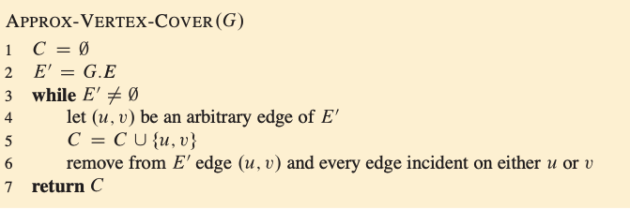
The vertex-cover problem
algorithm

Slide 13
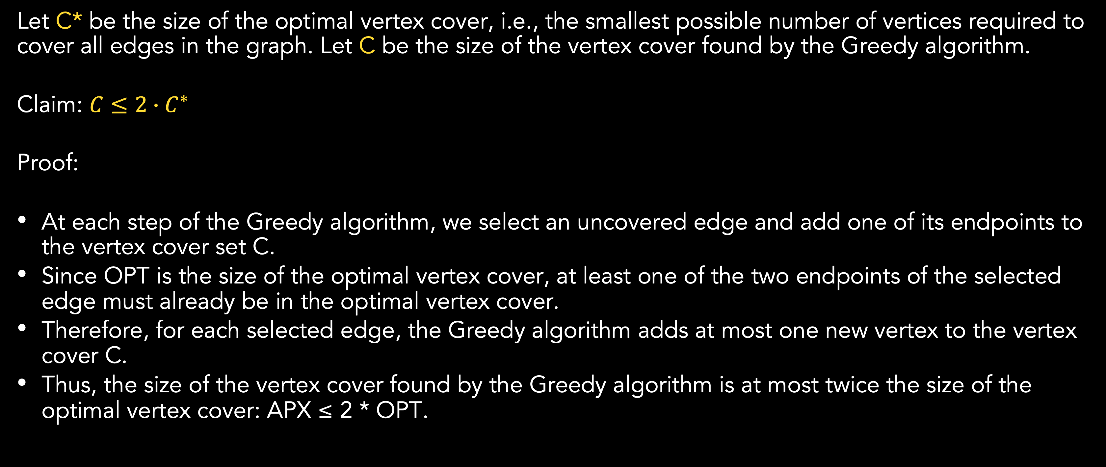
The vertex-cover problem
Proof
Let C* be the size of the optimal vertex cover, i.e., the smallest possible number of vertices required to cover all edges in the graph. Let C be the size of the vertex cover found by the Greedy algorithm.
Claim: $C≤2∙C^{∗}$
Proof:
At each step of the Greedy algorithm, we select an uncovered edge and add one of its endpoints to the vertex cover set C.
Since OPT is the size of the optimal vertex cover, at least one of the two endpoints of the selected edge must already be in the optimal vertex cover.
Therefore, for each selected edge, the Greedy algorithm adds at most one new vertex to the vertex cover C.
Thus, the size of the vertex cover found by the Greedy algorithm is at most twice the size of the optimal vertex cover: APX ≤ 2 * OPT.

Slide 14
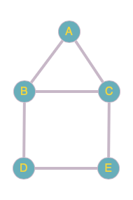
The vertex-cover problem
SAMPLE cASE
In this graph, the vertices are {A, B, C, D, E}, and the edges are {(A, B), (A, C), (B, C), (B, D), (C, E), (D, E)}.
Now, let's apply the Greedy algorithm to find an approximate vertex cover for this graph.
Initialize C={}
E’ = {(A, B), (A, C), (B, C), (B, D), (C, E), (D, E)}

Slide 15
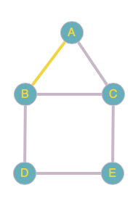
The vertex-cover problem
SAMPLE cASE
E’ = {(A, B), (A, C), (B, C), (B, D), (C, E), (D, E)}

Slide 16
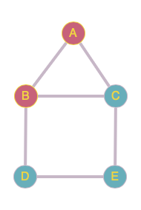
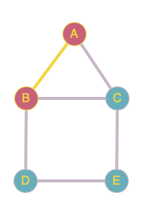
The vertex-cover problem
SAMPLE cASE
C = {A, B}
E’ = {(A, B), (A, C), (B, C), (B, D), (C, E), (D, E)} (Delete all edges incident to A or B)
E’ = {(C, E), (D, E)}

Slide 17
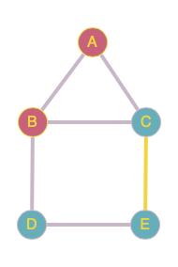
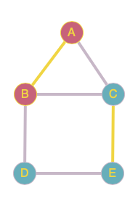
The vertex-cover problem
SAMPLE cASE
E’ = {(C, E), (D, E)}

Slide 18
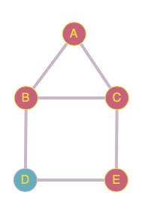
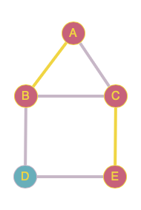
The vertex-cover problem
SAMPLE cASE
C = {A, B, C, E}
E’ = {(C, E), (D, E)} (Delete all edges incident to C or E)
E’ = {}

Slide 19
The vertex-cover problem
SAMPLE cASE
C = {A, B, C, E}
There are 4 vertices needed to cover all edges in the graph.
The optimal C* has 3 vertices (could be C*={A, B, E} or C*={B, C, E}), so for this exact graph, the approximation ratio is 4/3.

Slide 20
Linear programming
Definition
Many problems take the form of maximizing or minimizing an objective, given limited resources and competing constraints.
If you can specify:
The objective as a linear function of certain variables,
The constraints on resources as equalities or inequalities on those variables,
Then you have a linear-programming problem.

Slide 21
Linear programming
Problem formulation
Linear programs arise in a variety of practical applications. We begin by studying an application in chocolate manufacturing:
Consider a chocolate manufacturing company that produces only two types of chocolate – Reguler and ChocoMax. Both the chocolates require Milk and Choco only. To manufacture each unit, the following quantities are required:
Each unit of Reguler requires 1 unit of Milk and 2 units of Choco
Each unit of ChocoMax requires 1 unit of Milk and 3 units of Choco
The company kitchen has a total of 5 units of Milk and 12 units of Choco. On each sale, the company makes a profit of
$5 per unit Reguler sold
$6 per unit ChocoMax sold.
How many units of Reguler and ChocoMax should it produce respectively?

Slide 22
Linear programming
Problem formulation
We represent the problem in tabular form:
Let Reguler be X and ChocoMax be Y.
By examining the table, we can say that the objective is to maximize the profit, which is 5X + 6Y
Then, we also have several constraints.
 | Milk | Choco | Profit per unit
Reguler | 1 | 2 | $5
ChocoMax | 1 | 3 | $6
Total | 5 | 12

Slide 23
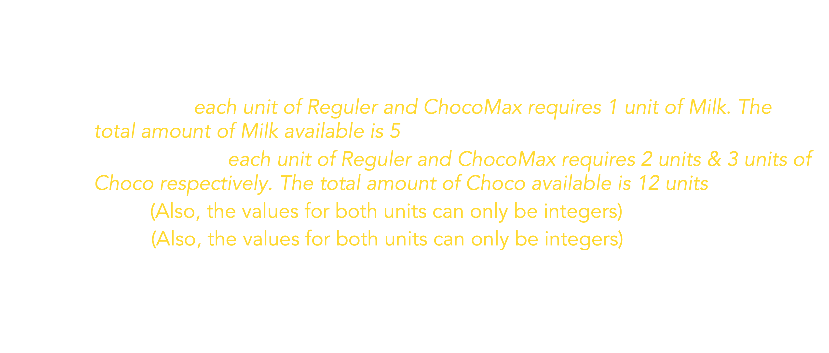
Linear programming
Problem formulation
The problem in linear programming would be:
Maximize 5X + 6Y
Subject to:
$X+Y≤5$ (each unit of Reguler and ChocoMax requires 1 unit of Milk. The total amount of Milk available is 5)
$2X+3Y≤12$ (each unit of Reguler and ChocoMax requires 2 units & 3 units of Choco respectively. The total amount of Choco available is 12 units)
$Y≥0$ (Also, the values for both units can only be integers)
$X≥0$ (Also, the values for both units can only be integers)

Slide 24
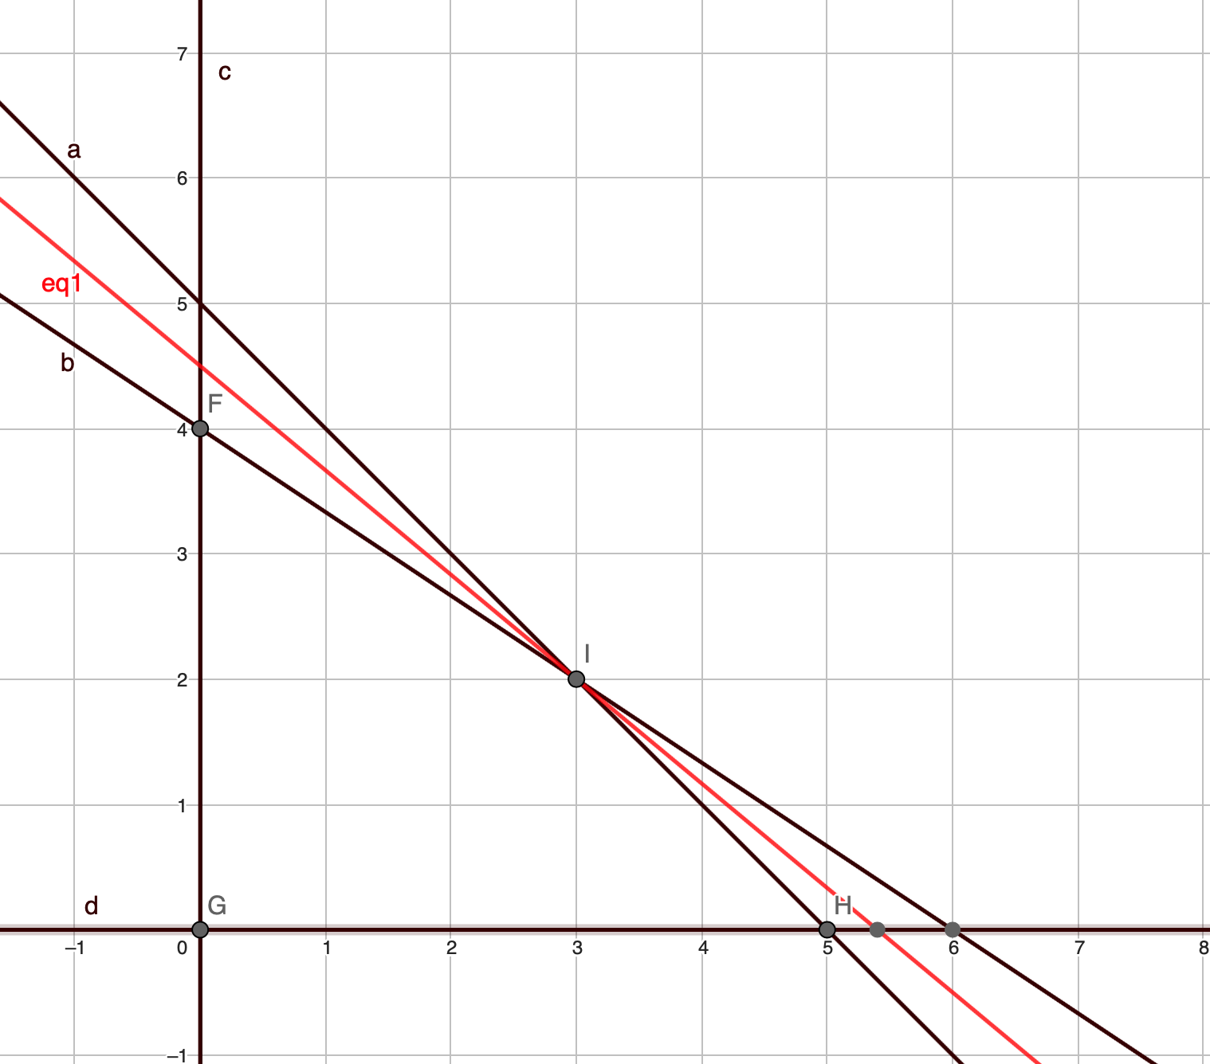
Linear Programming
Solving with geometric procedure
Here, we have searched for each intersection point F, I, G, H for the maximum value for 5X+6Y, which is 27 on point I.
We can see that X = 3 and Y = 2 as feasible solution which has objective value of 27.

Slide 25
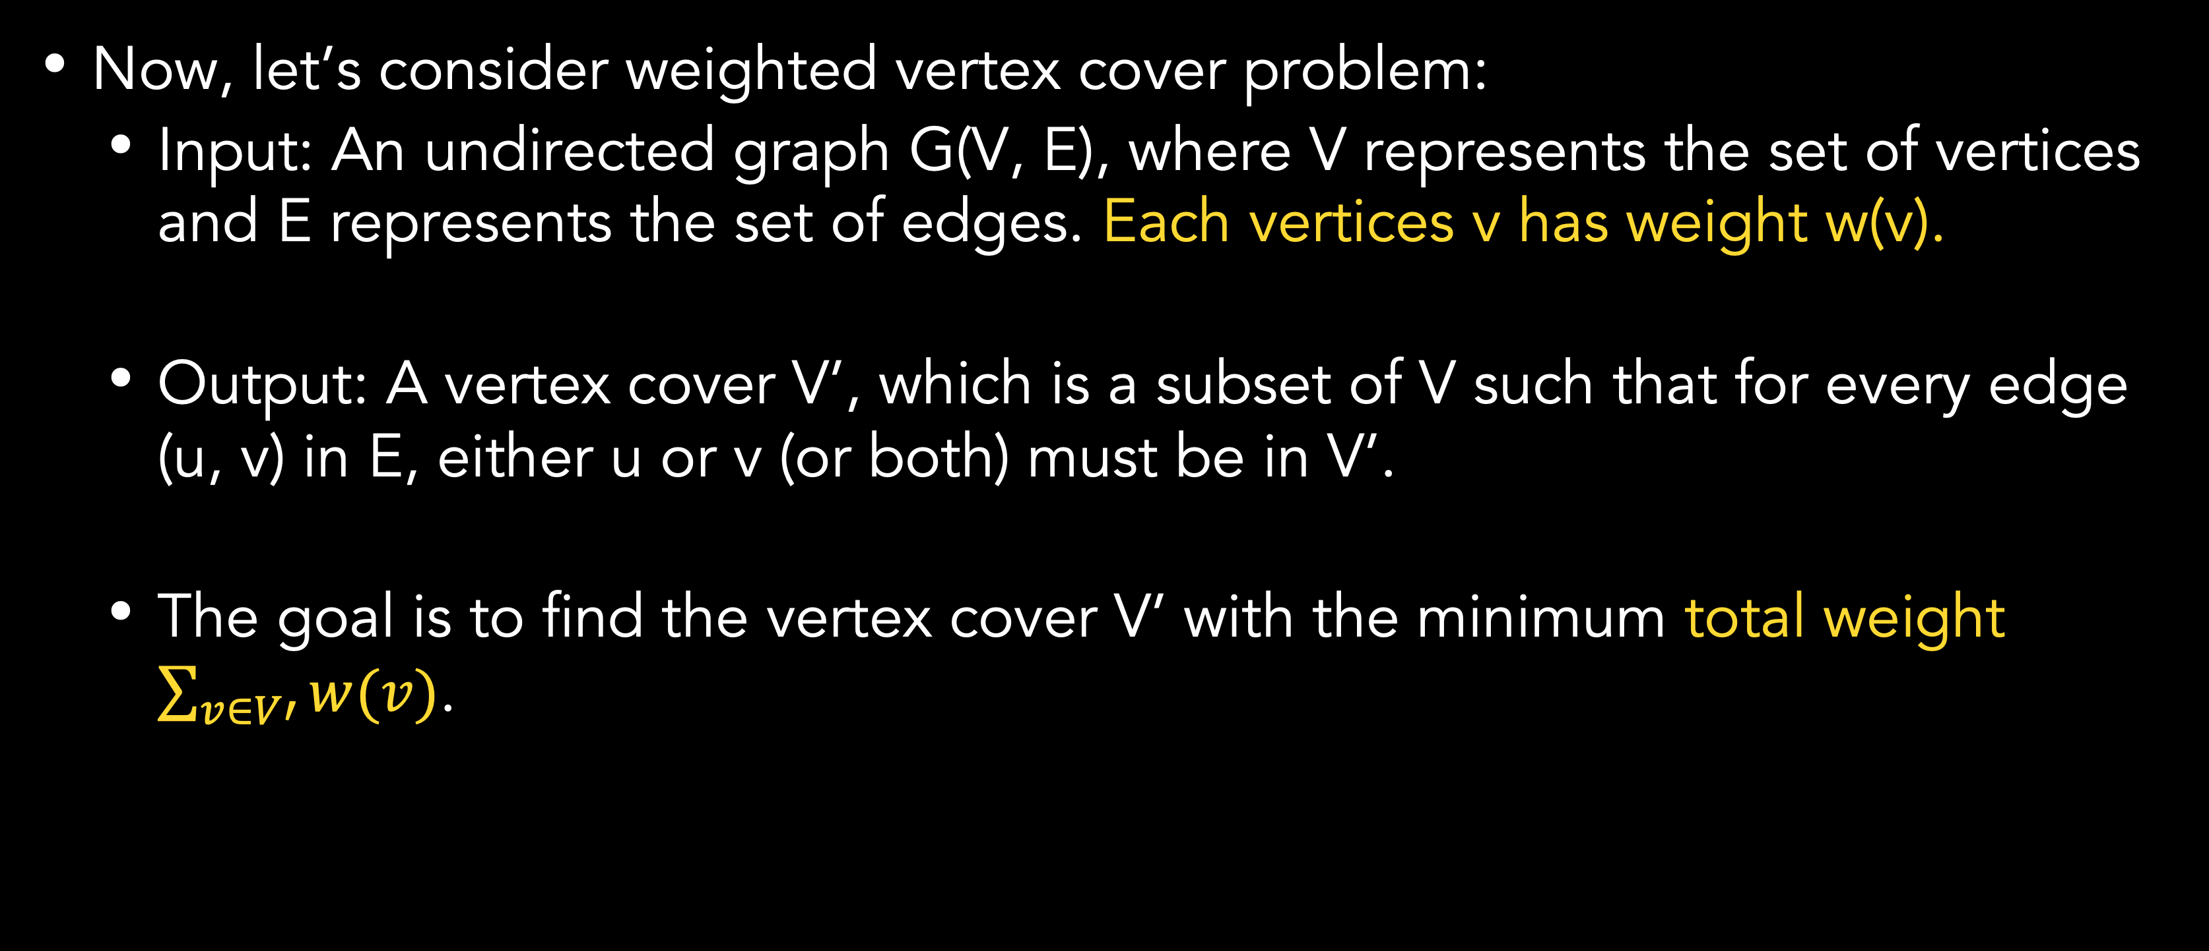
Approximating weighted vertex-cover problem using linear programming
Weighted vertex-cover problem
Now, let’s consider weighted vertex cover problem:
Input: An undirected graph G(V, E), where V represents the set of vertices and E represents the set of edges. Each vertices v has weight w(v).
Output: A vertex cover V’, which is a subset of V such that for every edge (u, v) in E, either u or v (or both) must be in V’.
The goal is to find the vertex cover V’ with the minimum total weight $\sum_{v∈V′}{w(v)}$.

Slide 26
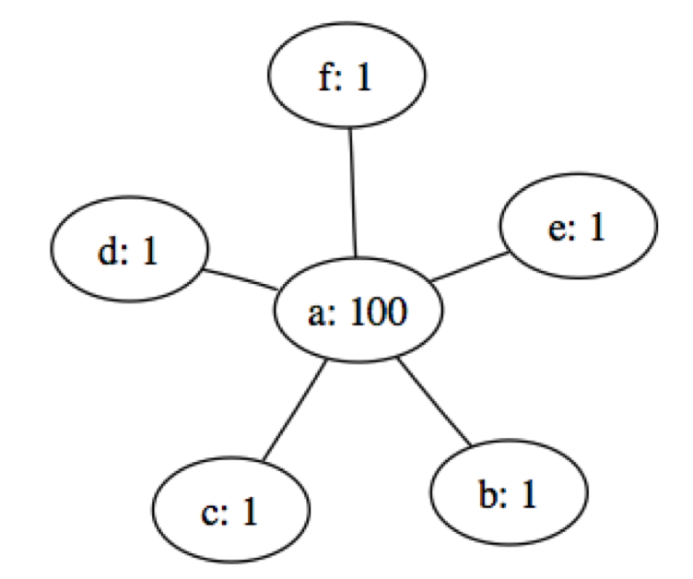
Approximating weighted vertex-cover problem using linear programming
Weighted vertex-cover problem
The greedy approximation algorithm from before will not work here as we can see from the example
The greedy approximation algorithm would start with (a, b) and cover it by putting {a, b} into C.
Cover all edges, but weighted 101
Much worse than the optimal solution which consist of picking vertices {b, c, d, e, f}, the total weight would be only 5.

Slide 27
Approximating weighted vertex-cover problem using linear programming
Weighted vertex-cover problem
How do we develop a 2-approximate algorithm for the problem?
Compute a lower bound on the weight of the minimum-weight vertex cover using a linear program.
“Round” this solution and use it to obtain a vertex cover.

Slide 28
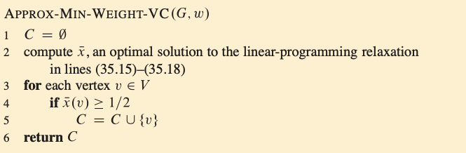



Approximating weighted vertex-cover problem using linear programming
Weighted vertex-cover problem

Slide 29
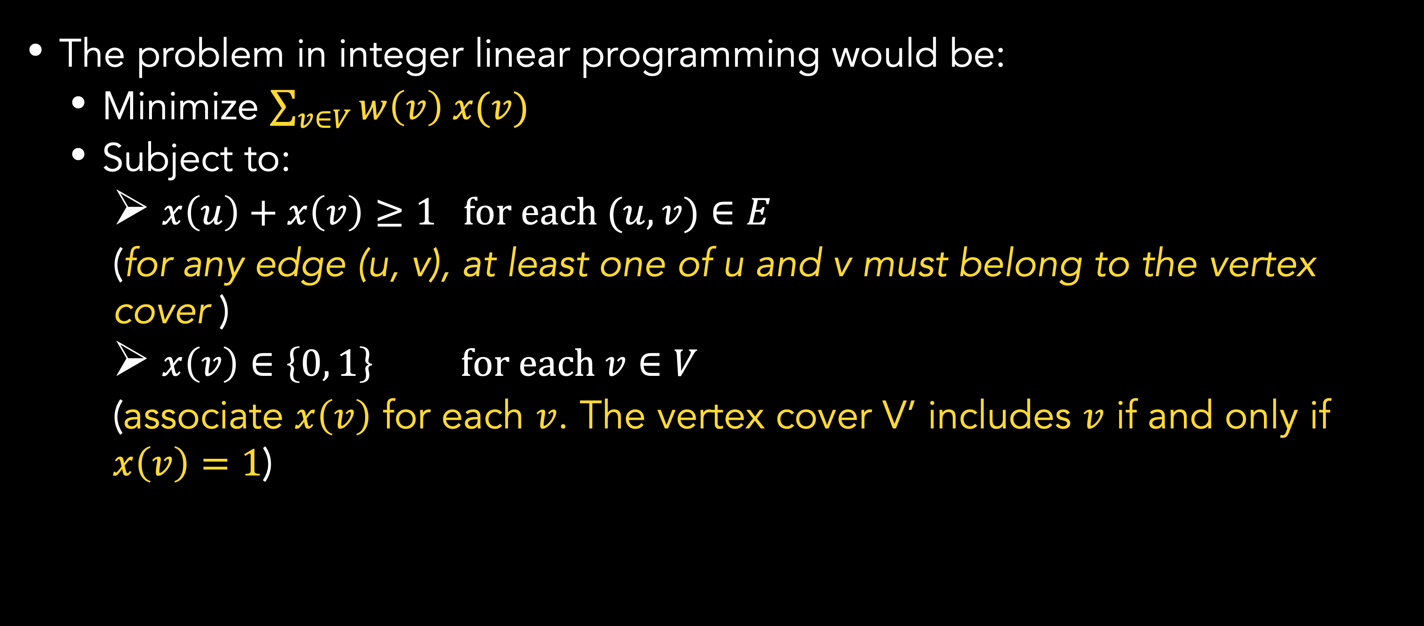
Approximating weighted vertex-cover problem using linear programming
Linear programming relaxation
The problem in integer linear programming would be:
Minimize $\sum_{v∈V}{w\left(v\right) x(v)}$
Subject to:
$x\left(u\right)+x\left(v\right)≥1 for each (u, v)∈E$
(for any edge (u, v), at least one of u and v must belong to the vertex cover )
$x\left(v\right)∈\left\{0, 1\right\} for each v∈V$
(associate $x\left(v\right)$ for each $v$. The vertex cover V’ includes $v$ if and only if $x\left(v\right)=1$)

Slide 30
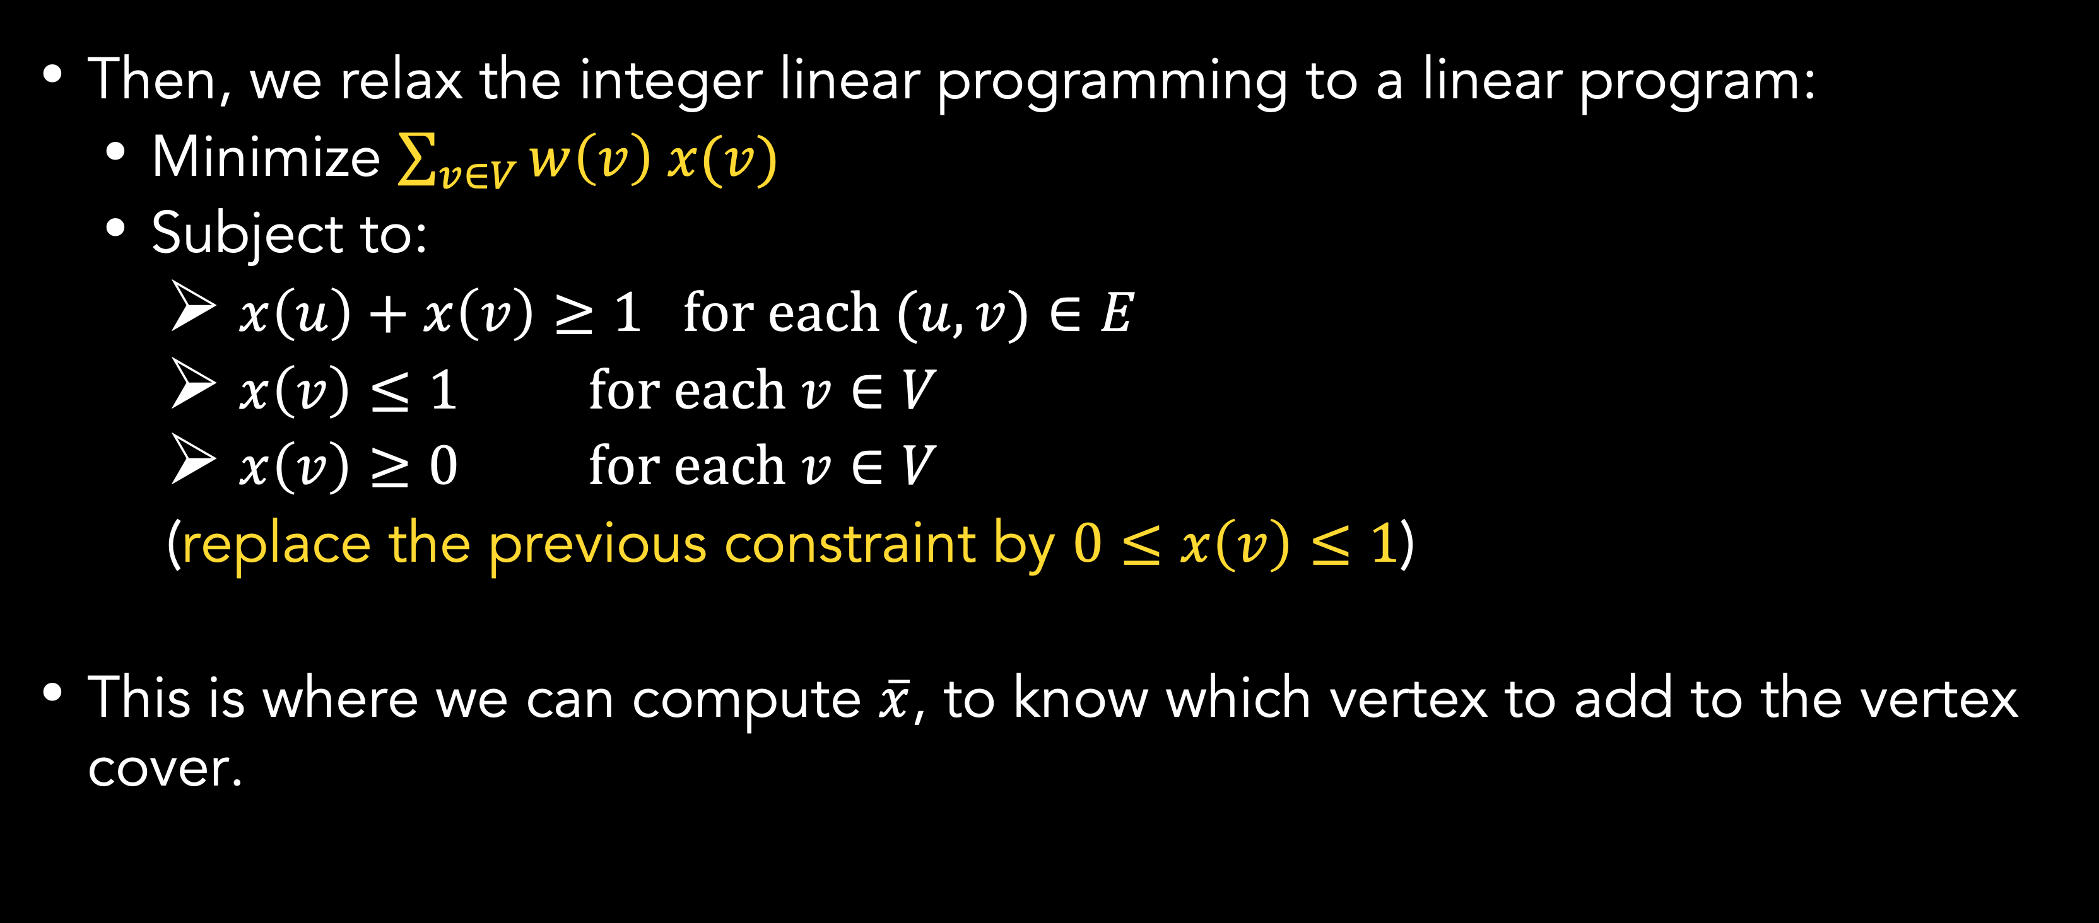
Approximating weighted vertex-cover problem using linear programming
Linear programming relaxation
Then, we relax the integer linear programming to a linear program:
Minimize $\sum_{v∈V}{w\left(v\right) x(v)}$
Subject to:
$x\left(u\right)+x\left(v\right)≥1 for each (u, v)∈E$
$x\left(v\right)≤1 for each v∈V$
$x\left(v\right)≥0 for each v∈V$
(replace the previous constraint by $0≤x\left(v\right)≤1$)
This is where we can compute $\overline{x}$, to know which vertex to add to the vertex cover.

Slide 31
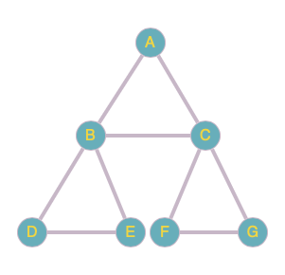
exercise
Apply the Greedy approximation algorithm to find an approximate vertex cover for the given graph.
Show each step of the algorithm, including the vertices added to the vertex cover at each step and the covered edges.
Also, calculate the size of the approximate vertex cover obtained using the Greedy algorithm and compare it to the optimal vertex cover size.
Optimal solution C* has vertex cover size of 4 (One solution could be C*={B, C, D, F}).

Slide 32
References
Thomas H. Cormen. (2022). Introduction to algorithms: Fourth edition. The MIT Press. Chapter 34.
http://theory.stanford.edu/~trevisan/cs261/lecture07.pdf
https://courses.engr.illinois.edu/cs598csc/sp2011/Lectures/lecture_4.pdf

Slide 33
Thank you
Approximation Algorithm: Vertex-cover
September, 2023

